Slide 1
Alarm Acknowledgement

Slide 2
Learning Objectives
By the end of this session, you will obtain a deeper understanding of:
The Life Cycle of an Alarm
In-Progressing
Dispatching
Logging Contact Attempts
Updating
Acknowledging

Slide 3
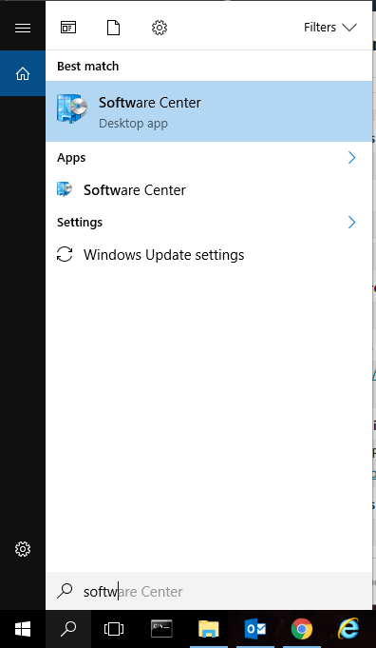
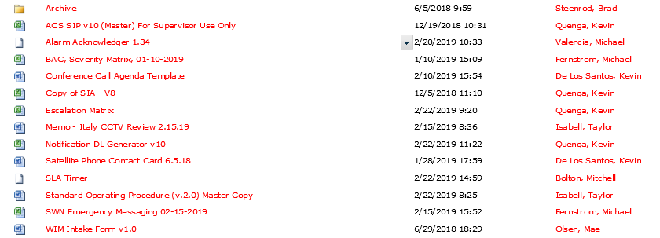
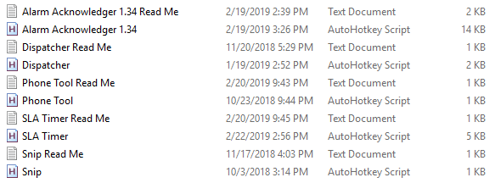
Policy
Amazon Corporate Security (ACS) acknowledges all alarms using the Hotkeys program found in the Software Center and the Alarm Acknowledger script found in the ACS-Back shared drive.
Notes:
v1.34 is the latest version of AA.

Slide 4
“In-Progressing” an Alarm
What is it?
Takes responsibility for the alarm
When do we do it?
When you are actively aware of and preparing to dispatch but prior to actual dispatch

Slide 5

Hot Keys
Notes:
All Alarm Acknowledger hot keys will use CTRL.
CTRL + up arrow will in-progress the currently selected alarms.

Slide 6
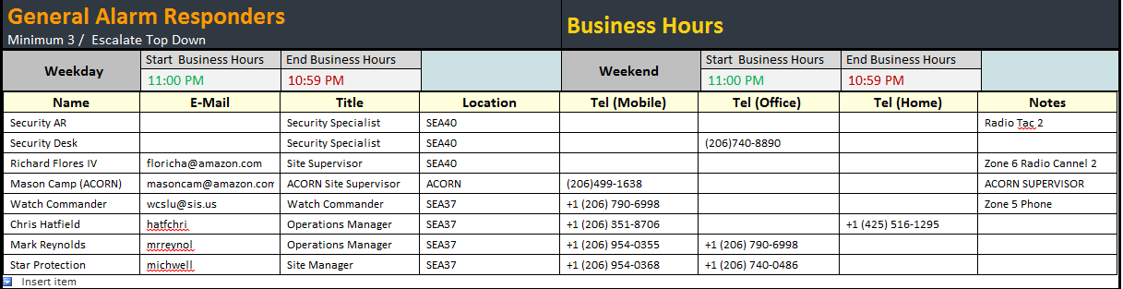
Dispatching
1
2
Notes:
After the alarm is marked In-Progress, you will see a yellow checkmark to the left of the alarm. Then you want to begin dispatching to the site using the preferred contact method. To determine the proper contact method, you will need to look at the Site Information Page (SIP) for that specific site. On the SIP, you will find a section with alarm responder information. Be sure to check the notes section for additional details about alarm dispatch methods. *For future training on SIP, see the SIP ATP*
Each of these contact attempts needs to be logged in Lenel, like this…

Slide 7
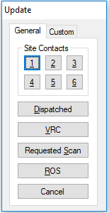
Hot Keys
CTRL + 1: Update Alarm
Will only update one alarm at a time.
Update Screen
Notes:
Ctrl + 1 will open up a Graphic User interface (GUI) that will provide you with a list of options for updating alarms.
Be advised this feature can only update one alarm at a time.
Add any notes as necessary (ex. SEA18 enroute to SEA81 Alarm)
Notes are also useful when passing alarms off during shift change, breaks, lunches, etc.
No limit on number of updates
Add any information received or steps taken
Cameras showed _____
Trace confirms _______
Easy way to get exact time of pending alarm

Slide 8
Life Cycle
Step 1: CTRL + “Up Arrow”
Step 2: Ref appropriate SIP and dispatch the alarm
Step 3: CTRL + 1 (Brings up the Update GUI)
Select either 1 – 6 (based off SIP escalation)
Step 4: CTRL + 1 (a 2nd time)
Select “Dispatched”
Step 5: Update with “ROS” When the alarm responder arrives at the alarm point/Responder arrives on scene
CTRL + 1 > Select “ROS”
Notes:
Step 1: CTRL + “Up Arrow”
Step 2: Ref appropriate SIP and dispatch the alarm
Step 3: CTRL + 1 (Brings up the Update GUI)
Select either 1 – 6 (based off SIP escalation)
Step 4: CTRL + 1 (a 2nd time)
Select “Dispatched”
Step 5: Update with “ROS” When the alarm responder arrives at the alarm point/Responder arrives on scene
CTRL + 1 > Select “ROS”
The ROS update should be made when the first responder arrives on the scene of the alarm, either self-reported or viewed/confirmed by camera or badge trace. For priority alarms, this is the same 12-minute SLA. The guard force will continue to be assessed on the time at which they badge+pin at the devices.

Slide 9
Situational Steps
If the alarm is classified as Priority in Lenel:
Direct the responding guard to scan their badge at the device that generated the alarm and enter their PIN on the reader
Review CCTV. Based on CCTV review, reference the appropriate procedure, if needed.
If a person is noted in the area, provide their description to security responders.
Once CCTV review has been completed, update the alarm with “VRC”
Ask the responding guard, “Did you swipe your badge and put in a PIN at the security device?” Once confirmed, you can proceed to acknowledge the alarm
Notes:
Highlighted Changes:
1. Direct the responding guard to scan their badge at the device that generated the alarm and enter their PIN on the reader
5. Ask the responding guard, “Did you swipe your badge and put in a PIN at the security device?”

Slide 10
“Acknowledging” an Alarm
Taken care of or completed
What is it?
Recording specific details about alarm and who cleared it
When do we do it?
Only after cleared by site
How do we do it?

Slide 11
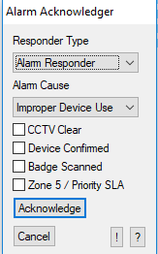
Hot Keys
CTRL + 0: Acknowledge Alarm
Will acknowledge all highlighted alarms in Lenel
Acknowledge Screen
Notes:
CTRL + 0 will create a GUI where you can enter in all required information to clear an alarm.
Be advised that if you change the alarm responder type to “Other” an additional input box will open up and require you to specify the responder type.
Additionally if you select the “Zone 5 / Priority SLA” box you will be required to enter the D3 Priority/Zone 5 SLA Defect D3 #.

Slide 12
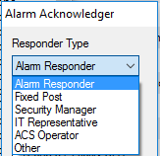
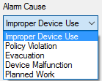
Acknowledging the Alarm
Step 6: Acknowledge
CTRL + 0
Responder Type (Dropdown)
Alarm Cause (Dropdown)
If a Priority Alarm, “Device Confirmed” and the “Badge Scanned” check boxes.
Notes:
Step 6: Acknowledge
CTRL + 0
Responder Type (Dropdown)
Alarm Cause (Dropdown)
When the site provides you with the details and the cause of the alarm, you are then able to add that information in Lenel by selecting the dropdown options and selecting the following shown above
Situational Steps (cont.):
If the time to acknowledge the alarm exceeds SLA, create an SLA Defect Ticket
If the alarm responder reports a forced entry, policy violation, device problem, or other issue, reference the appropriate procedure.
If the alarm is a Priority/Zone 5 alarm, security has arrived on scene and Badged and Pinned on the device, select the “Device Confirmed” and the “Badge Scanned” check boxes.
If security responders do not arrive at a priority alarm within 30 minutes or a Zone 5 alarm within 45 minutes:
Notify the RSM or Designee per the Escalation Matrix
Refer to Network Severance if requested by RSM or designee
If the alarm is Priority or Zone 5 and the time taken to complete the actions listed in Figure 1.1 exceed the listed times, create an SLA defect ticket.
If you select "Zone 5 / priority SLA" or "Responder Type" "Other" a message box will pop up that makes you fill in the required information.

Slide 13


Slide 14
Questions?

